Slide 1
CONDITIONAL STATEMENTS

Slide 2
CONDITIONAL STATEMENTS
If
If-else if
If-else
Nested if

Slide 3
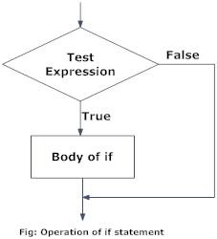
If Statement
An if statement is a programming conditional statement which, if proved true, performs a function.
If false, it simply skips it.

Slide 4
If Statement
Syntax :
if condition:
statement_1
statement_2
…
statement_n
In Python, the body of the if statement is indicated by the indentation.
Body starts with an indentation and the first unindented line marks the end.
Notes:
Here, the program evaluates the test expression and will execute statement(s) only if the text expression is True.
If the test expression is False, the statement(s) is not executed.

Slide 5
Example
a=10
if a==10:
print (“Hello User”)
Output:
Hello User
Notes:
Python interprets non-zero values as True. None and 0 are interpreted as False.

Slide 6
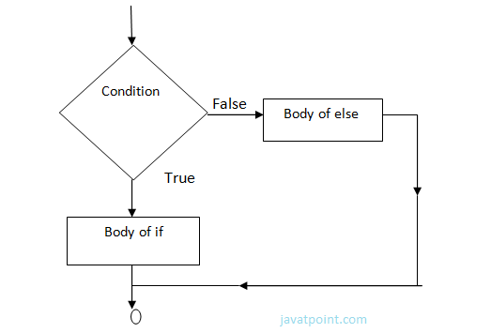
If-else Statement
An if else statement is a conditional statement that runs a different set of statements depending on whether an expression is true or false.

Slide 7
If-else Statement
Syntax:
if condition:
statements
else:
statements
In Python, the body of the if statement is indicated by the indentation.
Body starts with an indentation and the first unindented line marks the end.
Notes:
Here, the program evaluates the test expression and will execute statement(s) only if the text expression is True.
If the test expression is False, the else statement(s) is executed.

Slide 8
Example
n=5
if n%2==0:
print (“Number is even“)
else:
print (“Number is odd“)
Output:
Number is odd
Notes:
Python interprets non-zero values as True. None and 0 are interpreted as False.

Slide 9
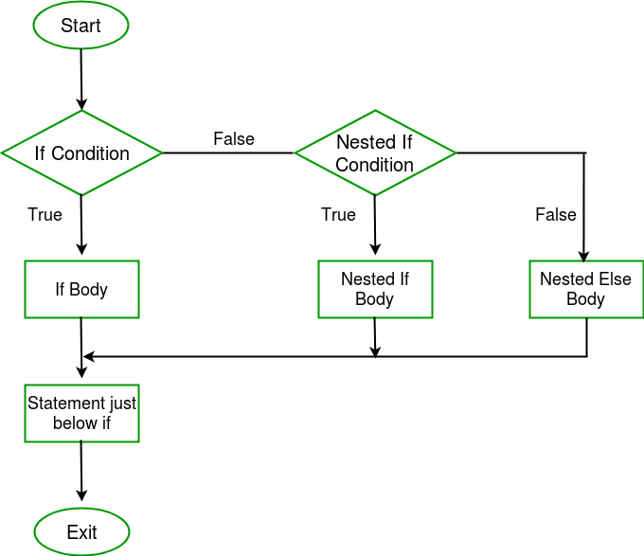
Nested if Statement
Nested if statements means an if statement inside another if statement.
i.e, we can place an if statement inside another if statement.

Slide 10
Nested if Statement
Syntax:
if condition:
if conditon :
statements
else:
statements
In Python, the body of the inner if statement is indicated by the indentation.
Notes:
Here, the program evaluates the test expression and will execute statement(s) only if the text expression is True.
If the test expression is False, the else statement(s) is executed.

Slide 11
Example
i = 16
if i < 15:
print ("i is smaller than 15“)
else:
if i > 20:
print ("i is also greater than 20”)
else:
print ("i is between 15 and 20 “)
Output:
i is between 15 and 20
Notes:
Python interprets non-zero values as True. None and 0 are interpreted as False.

Slide 12
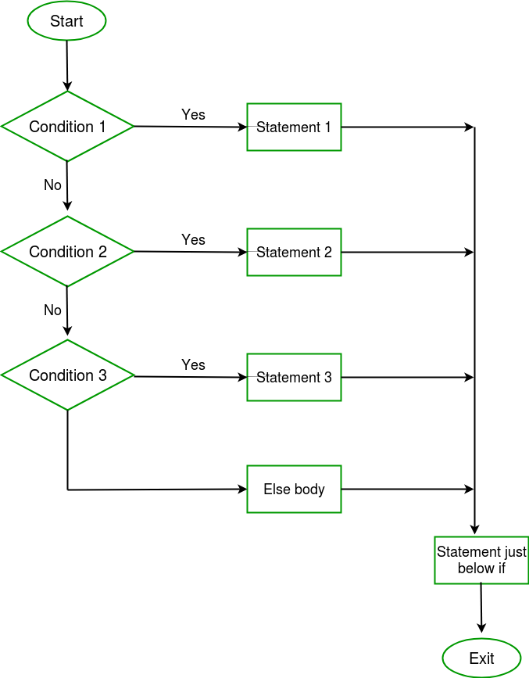
If else if Statement
The if statements are executed from the top down.
When one conditions is true, that block alone is executed, and the rest of the ladder is bypassed.
If none of the conditions is true, then the final else statement will be executed.

Slide 13
If else if Statement
Syntax:
if condition:
statements
elif conditon :
statements
else:
statements
In Python, the body of the if,elif and else statement is indicated by the indentation.
The first unindented line marks the end.
Notes:
Here, the program evaluates the test expression and will execute statement(s) only if the text expression is True.
If the test expression is False, the else statement(s) is executed.

Slide 14
Example
a=10
if a>20:
print (“a is greater than 20”)
elif a>15:
print (“a is greater than 15“)
else:
print (“a is less than 15“)
Output:
a is less than 15
Notes:
Python interprets non-zero values as True. None and 0 are interpreted as False.

Slide 15
LOOPING STATEMENTS

Slide 16
LOOPING STATEMENTS
For
Nested loops
While

Slide 17
For Loop
A for loop is used for iterating over a sequence.
It is like an iterator method as found in other object-orientated programming languages.

Slide 18
For Loop
Syntax:
for <variable> in <sequence>:
Keyword
list or tuple or dictionary or set or string
variable to iterate the loop
Keyword

Slide 19
Example
Program to display first 5 natural numbers:
Output:
1
2
3
4
5
Notes:
Python interprets non-zero values as True. None and 0 are interpreted as False.

Slide 20
Example
Loop continues till the last item in the sequence.
The body of for loop is separated from the rest of the code using indentation.
Program to display first 5 natural numbers:
for a in “12345”:
print (a)

Slide 21
While Loop
While Loop is used to execute number of statements or body till the condition passed in while is true.
Once the condition is false, the control will come out of the loop.

Slide 22
While Loop
Syntax:
while <condition>:
condition till which loop repeats
Keyword

Slide 23
Example
Program to print 1st 5 multiples of 5:
Output:
5 10 15 20 25
Notes:
Python interprets non-zero values as True. None and 0 are interpreted as False.

Slide 24
Example
Loop continues till the last item in the sequence.
The body of while loop is separated from the rest of the code using indentation.
The print function by default ends with newline character, to end with space we used
end = “ ” or end = ‘ ‘
Program to print 1st 5 multiples of 5:
a = 5
while a <= 25:
print (a, end = " ")
a = a + 5

Slide 25
Nested Loops
Loops defined within another Loop is called Nested Loop.
When an outer loop contains an inner loop in its body it is called Nested Looping.

Slide 26
Syntax
Syntax for nested for loop:
for iterating_var in sequence:
for iterating_var in sequence:
statements(s)
statements(s)
Syntax for nested while loop:
while expression:
while expression:
statement(s)
statement(s)
Notes:
Here, the program evaluates the test expression and will execute statement(s) only if the text expression is True.
If the test expression is False, the else statement(s) is executed.

Slide 27
Example
Program to print a pattern:
Output:
1
2 2
3 3 3
4 4 4 4
5 5 5 5 5
Notes:
Python interprets non-zero values as True. None and 0 are interpreted as False.

Slide 28
#note: the upper end is excluded in range.
It executes from 1 to i
When i=1 → j=1
When i=2 → j=1,2
When i=3 → j=1,2,3
When i=4 → j=1,2,3,4
When i=5 → j=1,2,3,4,5
When i=6 → j=1,2,3,4,5,6
Example
The outer loop is the first to start executing, followed by the inner loop.
The inner loop continues till end of sequence is reached, then the outer loop resumes.
Program to print 1st 5 multiples of 5:
for i in range(1,6):
for j in range (1,i+1):
print (i, end=" ")
print ()

Slide 29
Break Statement
With the break statement we can stop the loop before it has looped through all the items.
When break is encountered, the loop is exited and the lines after the loop is executed.

Slide 30
Example
for i in range(1,6):
if(i==4):
print ("loop breaks")
break
print (i, end=" ")
Output:
1 2 3 loop breaks
Notes:
Python interprets non-zero values as True. None and 0 are interpreted as False.

Slide 31
Example- Nested Loop
for i in range(1,6):
for j in range(1,4):
if(j==3):
print ("loop breaks")
break
print (i, end=" ")
print()
Output:
1 1 loop breaks
2 2 loop breaks
3 3 loop breaks
4 4 loop breaks
5 5 loop breaks
Output:
???
Notes:
Python interprets non-zero values as True. None and 0 are interpreted as False.

Slide 32
Example- Nested Loop
for i in range(1,6):
if(i==3):
print ("loop breaks")
break
for j in range(1,4):
print (i, end=" ")
print()
Output:
1 1 1
2 2 2
loop breaks
Output:
???
Notes:
Python interprets non-zero values as True. None and 0 are interpreted as False.

Slide 33
Continue Statement
With the continue statement we can stop the current iteration of the loop, and continue with the next.
When continue is encountered, it skips the current iteration.

Slide 34
Example - Loop
for i in range(1,6):
if(i==4):
print ("loop skips")
continue
print (i, end=" ")
print()
Output:
1 2 3 loop skips 5
Notes:
Python interprets non-zero values as True. None and 0 are interpreted as False.

Slide 35
Example-Nested Loop
Output:
1 loop skips
3
1 loop skips
3
1 loop skips
3
1 loop skips
3
1 loop skips
3
for i in range(1,6):
for j in range(1,4):
if(j==2):
print ("loop skips")
continue
print(j, end=" ")
print()
Output:
???
Notes:
Python interprets non-zero values as True. None and 0 are interpreted as False.

Slide 36
Example
for i in range(1,6):
if(i==3):
print ("loop skips")
continue
for j in range(1,4):
print (i, end=" ")
print()
Output:
1 1 1
2 2 2
Loop skips
4 4 4
5 5 5
Output:
???
Notes:
Python interprets non-zero values as True. None and 0 are interpreted as False.

Slide 37
Pass Statement
Interpreter ignores a comment entirely
Pass is a null statement.
Then what is the difference between pass and comment???
Nothing happens when pass is executed

Slide 38
Example
for i in range(1,6):
if(i%2==0):
pass
else:
print(i)
Output:
1
3
5
Output:
???
Notes:
Python interprets non-zero values as True. None and 0 are interpreted as False.

